Slide 1
Introduction to Fragments
IN721 2017
Design and Development for Mobile Devices
Session 6.1
Notes:
The core framework of Android rests on the Activity and the Intent.
In our work with building apps for phones, we have seen this system work well: one Activity, one Screen.
Like this…

Slide 2
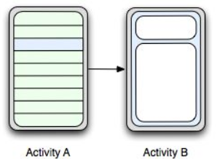
Activities
Notes:
Image from gigaom2.files.wordpresscom
Here is a schematic of a two-Activity app. Activity A is the nav, and when you select an item, you get Activity B.
But then, people started using tablets. Tablets are much bigger than phones.
If you build them correctly, Android applications can cope gracefully with this. By using wrap_content and fill_parent you get the “fluid layout” effect, where screen contents stretches to fill the screen.
On a tablet, the above application would look like this:

Slide 3
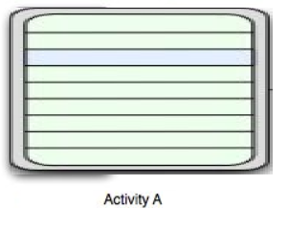
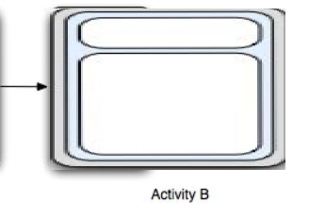
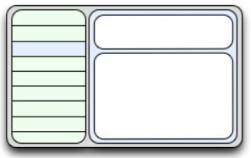
Activities
Notes:
But this is silly.
Each of Activity A and Activity B took up much less space originally, so presumably they only require that much space.
If you set them up to stretch, they will fill the screen. If you don’t there will be a lot of empty space. Either way: weird.
When we are on a tablet, it would be much better if we could somehow pack both of those activities into a single screen....
Like this...
The left-hand part would still be the nav. When you clicked on it, the contents of the right-hand part could change.
Early versions couldn’t do this. You could have one Activity and one screen and that was that.
Of course you could write a single Activity with a Relative Layout holding all the controls that would look like the one on the tablet. And you could write the necessary code to make a click on the left dynamically modify the content on the right.
You can programmatically identify the size of the device, and put a lot of conditional logic into your app to use the correct code on different device sizes.
But this essentially means writing two completely separate implementations of the same functionality.
You already did everything you need when you wrote Activity A and Activity B for the phone. What you wanted to be able to do was just them both on the screen.
But now you need a whole lot of new logic to combine the work of A and B and manage the conditional display stuff with showing and hiding and rearranging controls.
What we really want to do is just be able to put more than one Activity class onto the screen at the same time.
By the time Ice Cream Sandwich was released, there were enough tablets around that the Android people decided they needed to support functionality of this kind.
The decided to add to the language a new class, basically a little portable module, who could hold controls and respond to user events and had a proper lifecycle which you could embed into Activities of various sizes.
This way, you wrote the A and B classes once. For the phone, you put them in separate Activities. For the tablet you put them side by side in a single Activity.
This class is Fragment.

Slide 4
Fragment
Requires a java class and an XML layout.
Can contain any required controls.
Has a life cycle and can respond to user actions on its controls.
Must be instantiated within an Activity.
The Activity uses placeholders in its own layout, which it can replace at runtime with any Fragment.
Fragments are created dynamically in the code behind, and bound to these Activity placeholder elements.
Notes:
Let’s look at how it works...
Here are the steps, and next we will look at the code.
Can’t exist by itself. (In the designer, will look independent, but isn’t really.)
You will create a (descendant of) a Fragment class, not an Activity class. Activity instances descend from android.Activity. Fragments descend from android.Fragment

Slide 5
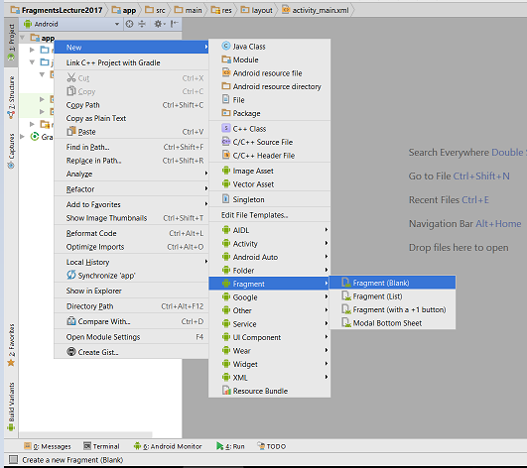
Creating a Fragment
Notes:
Add a class skeleton and default layout file.
(You can also do all of this by hand, of course.)

Slide 6
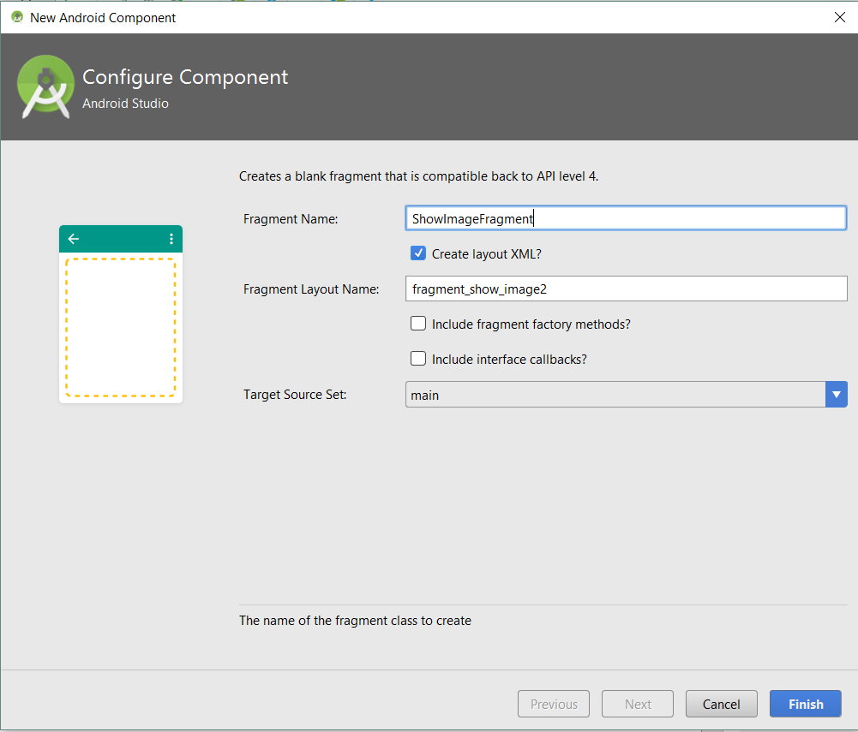
Creating a Fragment
UNCHECK THESE
Notes:
This is 2.3. Your screen may be arranged slightly differently, but you need to make sure to uncheck the methods and callbacks buttons.
Failing to do so will introduce a bunch of code we aren’t ready to use yet.

Slide 7
Defining a Fragment
Set up your XML layout.
Write the code-behind for your Fragment class descendent, which includes the code to connect the Fragment to its layout.
Notes:
Again. NOT AN ACTIVITY

Slide 8
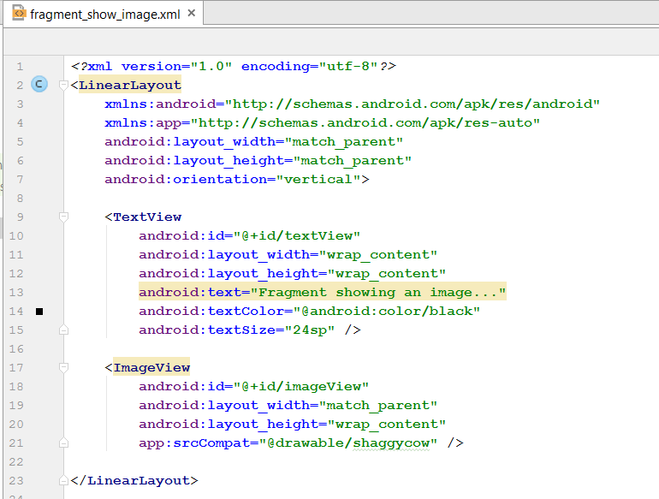
Defining a Fragment
Set up an XML layout for the Fragment
Notes:
You’ll get a typical skeleton like the Hello World you get for Activities. Just make it into whatever you want
Remember in the “Phone to tablet” example at the start, we wanted one element for the nav and one for the content. So you would set up one Fragment with nav control(s) and one with the content control(s).
In this example, I want to have a fragment that displays an image and a caption. So I place a TextView and ImageView just like always.
(NB: The XML the system makes for you may use a FrameLayout. FrameLayouts are handy for complex z-order. If you’re interested, check the docs. In this example, for simplicity, I’ve just replaced the generated XML with a nor LinearLayout.)
Perfectly normal.
In the graphical view, it looks like any other layout...

Slide 9
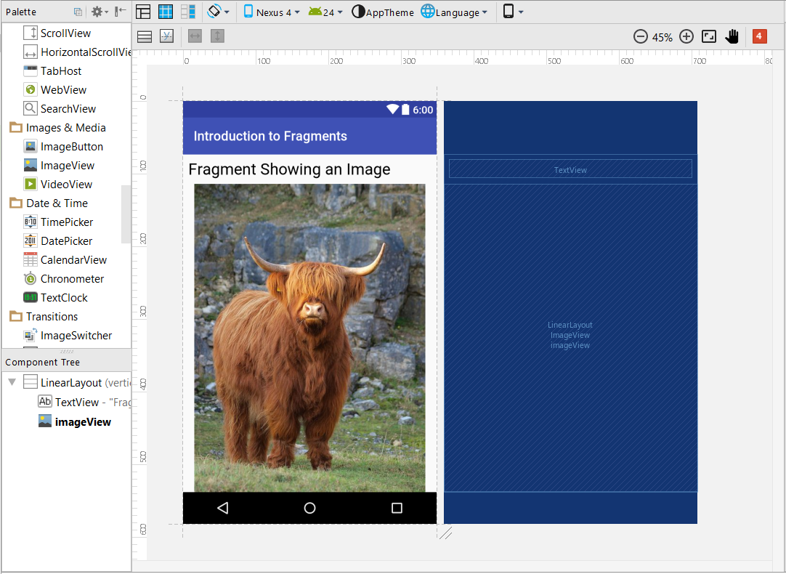
Defining a Fragment
Create an XML layout.
Notes:
Perfectly normal.
In the graphical view, it looks like any other layout...
But it isn’t the same as an Activity, and it won’t necessarily look like this on the phone.
At runtime, the Fragment will be placed inside a placeholder element in the layout of the Activity. And its location in the app’s layout will depend on where that placeholder is.
We can place this quite independently into Activities...

Slide 10
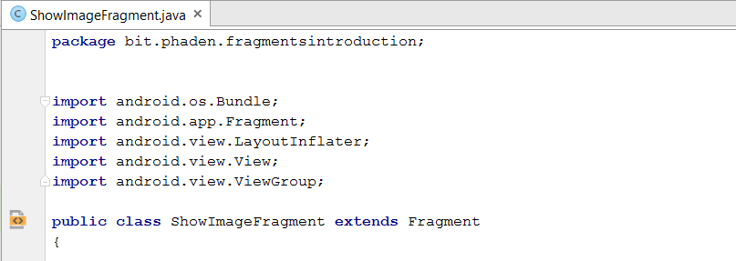
Fragment Code-Behind
Create a class that extends Fragment.
Notes:
Here is the start of the class file.
Just normal java stuff here....
You can do an Add->New->Fragment, or just do it all manually.
When importing Fragment, and some of the related classes we will see later, you will often have options for plain app or support.v4.app. Support libraries offer greater backward compatibility, which isn’t critical for us right now, so we can use the regular app ones throughout. Change this one if it comes up with supprt.v4 on your machine.)
Fragment is an existing android class
Now we connect this class to the XML layout we made for it.
For Activities, this just requires passing the resource ID of the layout to the Activity’s setContentView method (in the onCreate).
For Fragments, it’s more complicated.

Slide 11

Fragment Code-Behind
Bind the XML layout in the Fragment’s onCreateView event handler
LayoutInflater inflater: a system object that knows how to translate XML into controls.
ViewGroup container: The Activity who is instantiating the fragment.
Bundle savedInstanceState: State information if this Fragment is coming back from Pause or Stop.
Notes:
You have seen that, when an Activity is launched, the system raises its onCreate method, and we can write our initialisation code in there.
We connect the Activity to its layout via the setContentView method.
The logic is much the same for Fragments, but the mechanics are a bit more complicated (we will see in a moment how Activities request the creation of their component Fragments).
When a Fragment is instantiated, the system raises the onCreateView event. That method returns a View – that is a collection of screen controls.
You will write code in that method to connect your layout and your Fragment class to produce the necessary in-memory objects.
The function prototype look like this (I’ve added some line feeds for clarity).
What we will do in the code is let the LayoutInflater translate the layout into a collection of controls (i.e. a View) and then return that View.
The code looks like this...

Slide 12
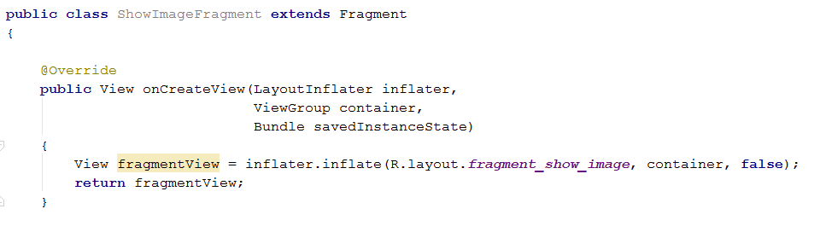
Fragment Code-Behind
Notes:
We call the LayoutInflater’s inflate(x,y,z) method.
It wants the resource ID of a layout from R (which we have already seen), the container that was passed into the event (almost always wants this one – we just send it on), and a boolean flag we will talk about later but which, for now, can just be false all the time.
This method returns the inflated controls (a View object) and we configure them if necessary (see example later in the ppt; why might we want to do that? => loading an Adapter, e.g.) and flick them on.

Slide 13
Instantiating a Fragment
The Activity puts a placeholder element in its XML layout.
When it wants to show a Fragment, it:
Creates an instance of the Fragment class.
Gets a FragmentManager object
Uses the Fragment Manager to replace the placeholder with the Fragment.
Notes:
Now the Fragment’s layout is defined.
It’s code-behind has the necessary statements to produce an actual memory object.
What we now need to arrange is that “embedding in an Activity” part.
It goes like this...
Sounds confusing. It is.
We will break it down into several steps.

Slide 14
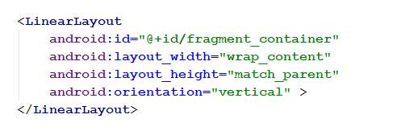
Instantiating a Fragment
The Activity puts a placeholder element in its layout xml file.
Notes:
This part is easy.
Just put any member of the Layouts classes – LinearLayout, RelativeLayout, etc.
Style it as appropriate.
My fragment layout will be inflated into the LinearLayout.
The result is the same as if I have taken all the elements in the fragment XML layout and copy-pasted them into here as the contents of the LinearLayout element.

Slide 15

Instantiating a Fragment
When the Activity wants to show a Fragment, it:
Creates an instance of the Fragment class.
Gets a FragmentManager object
Notes:
Remember the 3 steps? Here are the first two.
These two are straightforward...
Create the instance with a normal constructor call.
getFragmentManager is one of those Activity methods that is just hanging around waiting to do things for you. Like getResources().
Step 3 is the weird one...

Slide 16
Instantiating a Fragment
Uses the Fragment Manager to replace the placeholder with the Fragment.
Process:
Begin a transaction
Make all the changes you want to make to your Activity’s Fragments
Commit the transaction
Notes:
In our example, we are just going to place one fragment in our activity.
But there is no theoretical limit to how many changes you could make.
If you have lots of place holders, you could make lots of new fragments.
Or, you might want to remove some other fragments, or replace them.
The system doesn’t want to be recreating the Activity each time you make any change. It wants you to make all your changes in memory, and then push them out all at once.
This is similar to the way databases work, where an operation with multiple steps is done first in memory, and only pushed to the db when all the work is finished.
Here’s how it looks for our single “replace the placeholder with the fragment” operation..

Slide 17
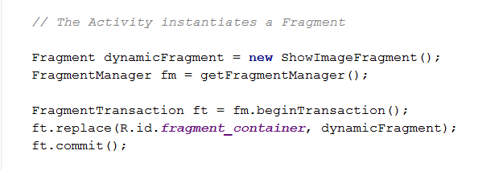
Instantiating a Fragment
Uses the Fragment Manager to replace the placeholder with the Fragment.
Notes:
The first two lines we’ve already seen.
We begin the transaction, which gets us a transaction object..
We tell it to replace fragment_container (remember him? He’s that linear layout...) with the dynamicFragment object
We’re done, so we tell him to commit.

Slide 18
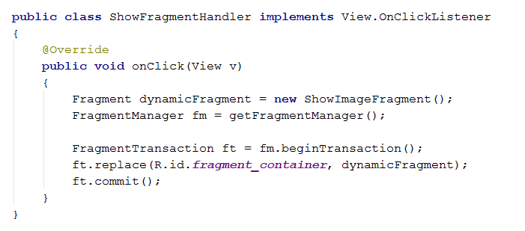
Instantiating a Fragment
Notes:
To see it in action, let’s put all that code into a button click handler.
Here is the inner class. Wire up as usual in the onCreate
When the Activity opens, no Cow.
Click the button = > Cow.

Slide 19
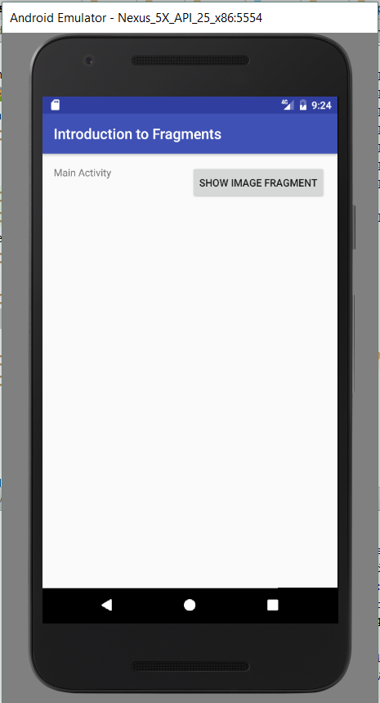
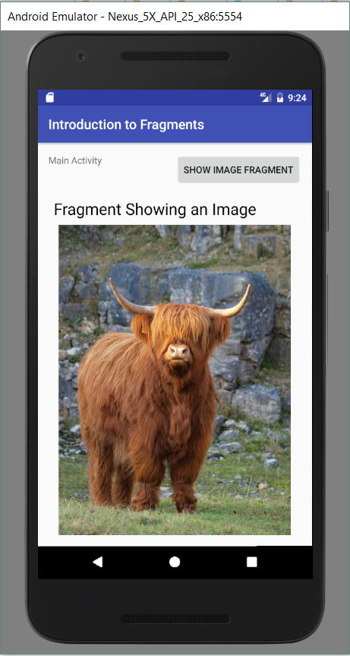
The App...
Notes:
On the left, it opens.
Then we click the button...
The fragment is created and embedded in the Activity’s layout.

Slide 20
Practical – Part 1
Extend the demo app so that there are two buttons:
Button 1: Displays a Fragment that contains an ImageView.
Button 2: Displays a Fragment that contains a ListView.

Slide 21
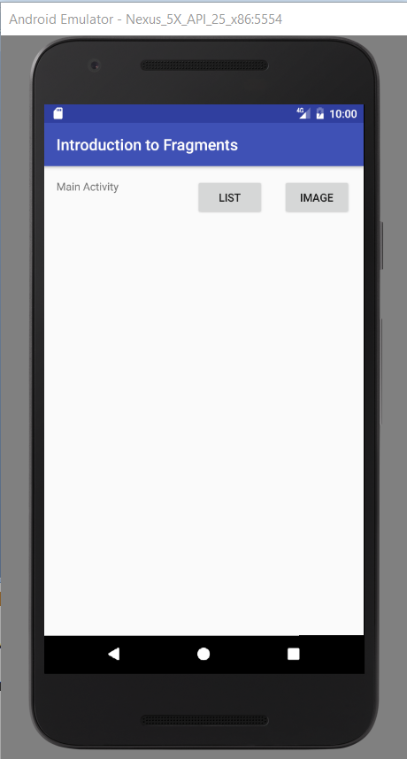
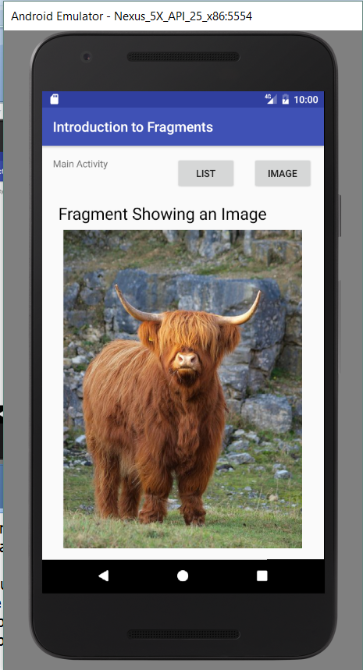
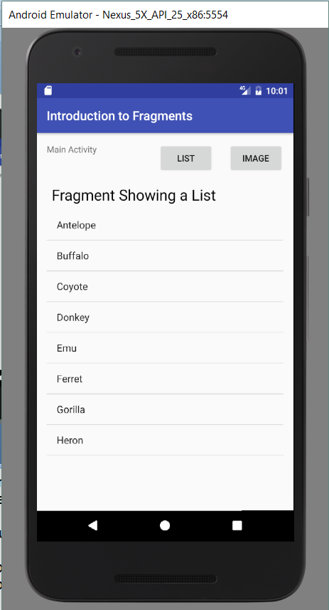
Practical – Part 1
Notes:
You will need to create the two Fragment classes and their supporting layouts.
You will attach to the button clicks the necessary code to load the fragment into the container.
This should be straightforward, except for one small thing => How do you get the contents into the ListView?
With the ImageView, its content (the drawable) is all in the XML, but we know that with ListViews we need an ArrayAdaptor.
Remember when we said you could do any set up your inflated View needed before returning it from onCreateView? This is the sort of work we were talking about.
Let’s look at how that fragment with the ListView is created...

Slide 22
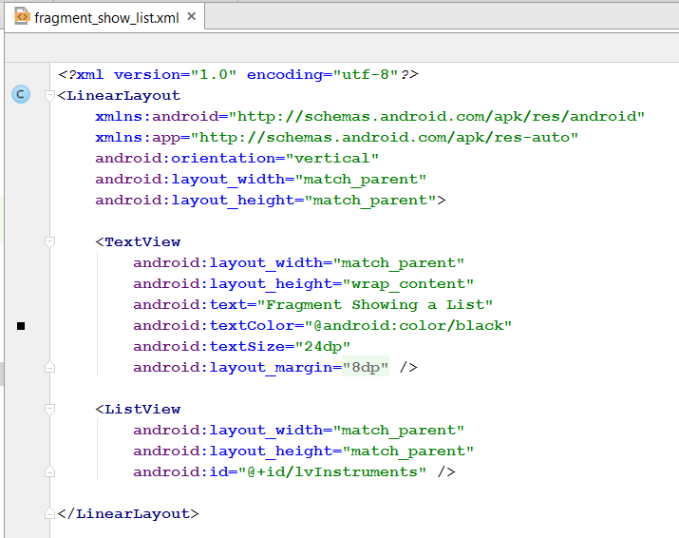
Practical – Part 1
Creating a Fragment with a ListView
Notes:
Assume you’ve got the layout, something like this...
There’s the empty ListView

Slide 23
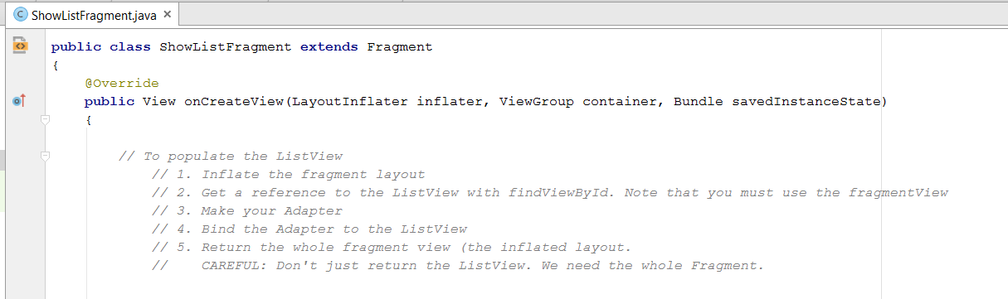
Practical – Part 1
Creating a Fragment with a ListView
Notes:
Then you need the code
Here we are in the onCreateView of the Fragment descendent
The comments describe the work we have to do before we return our inflated View fragmentView
This is all stuff you’ve done before, with a couple of small changes
First, you can’t just call findViewById here, like you can in the Activity class. Why is that?
This class is a descendent of Fragment. Fragments don’t have FindViewById
Luckily, Views do, and you just created a View with the inflater, so you can call findViewById on that view
Second, you are going to run into problems with your Adapter.
Remember the syntax of the Adapter constructor?

Slide 24

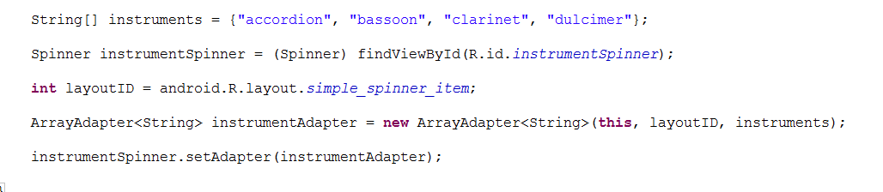
Practical – Part 1
Creating the ArrayAdapter<String>
Notes:
You recall that in our previous ListView loading code we did this, and it worked great.
But here, when we are making the adapter inside the Fragment class, we have a problem.
Specifically, who does this refer to?
The code above was contained in an Activity onCreate method, so this was the Activity, which is exactly what we need.
Inside the Fragment class, however, if we say this, we will be referring to the Fragment class, which will not work.
The ArrayAdapter constructor wants the Activity there (technically, it wants a Context object)
So you need a way to get the Fragment’s activity.
Fortunately, there is one. Fragments only exist inside an Activity, never on their own. So they have a method that will return a reference to the Activity they are living in at runtime.
That method is called getActivity()

Slide 25
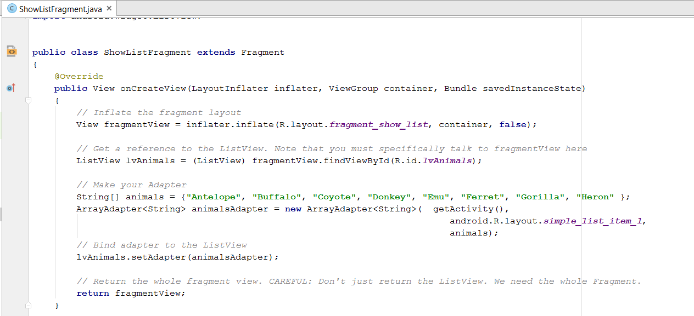
Practical – Part 1
Creating a Fragment with a ListView
Notes:
Here’s the whole thing.
Note that we use the fragment’s View to access findViewById
There’s the call to getActivity()
So here we have inflated the Fragment layout, setup the ListView and returned the whole thing to the calling Activity
Your remaining job for Part 1 of the practical is to get the Activity organised to create and use the correct Fragment at each button click.

Slide 26
Practical – Part 2. IMPORTANT
Modify your app to run on a tablet.
Allow both Fragments to be displayed at the same time.
Steps:
Create a new AVD for the tablet of your choice (e.g. Nexus 7) with a default Landscape orientation.
Add a new (landscape) layout to your project that can hold both fragments <= Important
Assign the new layout to the Activity in its onCreate by changing what you pass to setContentView
Adjust the button handler code as required.
Notes:
It is very important to complete this practical task. If you can’t get it to work, let me know.
This layout is much more complicated than the others we have done.
You will need to have a place for the buttons at the bottom, and two placeholders.
All three of these need a layout element
And all three of them must sit inside the root layout element.
It will help to make a sketch first.
It is very important that you complete this practical task. Learning to work with layouts is tricky, and we need to start now.

Slide 27
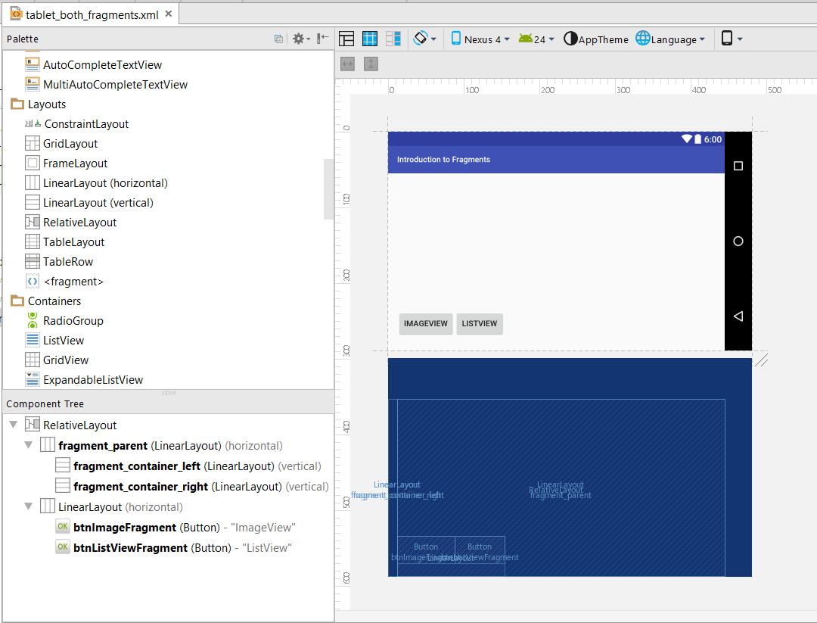
Practical Part 2
Notes:
You will need to make a new landscape AVD for emulation, and you will also want to make the Design View editor look like a tablet.
This control is useful

Slide 28
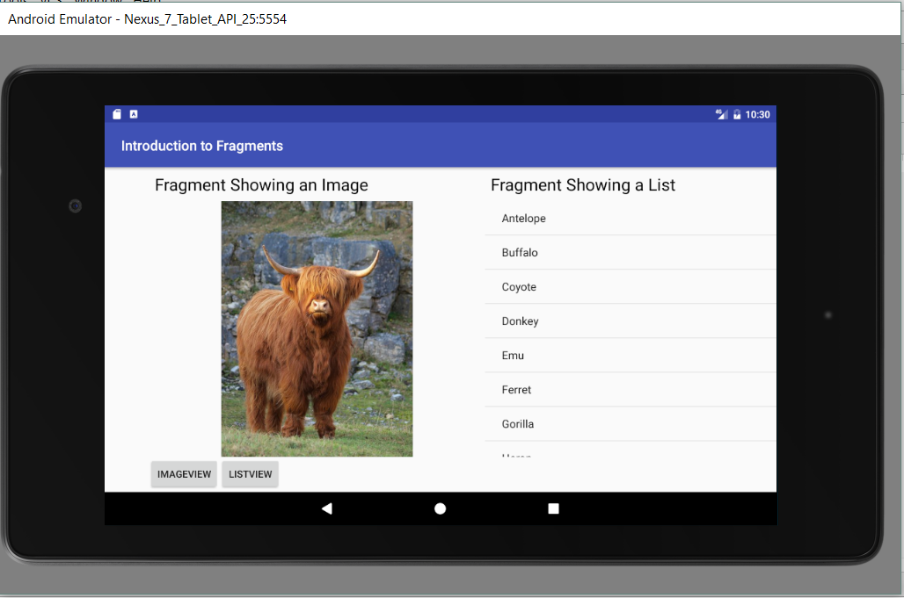
Practical – Part 2
Notes:
The app running in the emulator in my new tablet AVD, after both buttons have been clicked
Feel free to make the screen design more attractive.
Pay attention:
If you set up your two fragments correctly, the code modification should be quite trivial. (Making the new layout is 90% of the work.)
The Fragments already exist, so there is nothing to do to their code. Note that this would be true even if they had 1000s of lines of code.
That’s why Fragments are so important.

